Slide 1
Control statements
Selection
Iteration
Jump
C++ adds two additional statement types: the try block (used by exception handling) and the declaration statement.

Slide 2
Selection Statements
C++ supports two types of selection statements:
if statement
If …. else statement
Nested if ….. else statement
Else if ladder
Switch statement
The term conditional statement is often used in place of "selection statement”.

Slide 3
The If …… Else Statement
Its general form is;-
if (test expression)
{
true-block statement(s)
}
else
{
false-block statement(s)
}
statement-x

Slide 4
If the test expression is true then the true-block statements(s), immediately following the if statement are executed; otherwise the false-block statements are executed.
#include <iostream>
using namespace std;
int main()
{
int marks;
cout<<"enter your marks:";
cin>>marks;
if(marks>=50)
cout<<"You passed" <<endl;
else
cout<<"You failed" <<endl;
return 0;
}

Slide 5
.
EX: program to check given number is either odd or even
# include <iostream>
int main()
{
int a;
cout<<“Enter the number to be checked”<<endl;
cin>>a;
if ( (a%2) = = 0)
cout<<“The given number is even”;
else
cout<<“The given number is odd”;
}

Slide 6
Nesting if Statements
When series of decisions are involved, we may have to use more than one if .. else statements in nested form.

Slide 7
The general form for nested if…. else statement is;
if (test-conditions-1)
{
if (test-conditions-2);
{
statement-1;
}
else
{
statement - 2;
}
}
else
{
statement-3;
}
statement-x

Slide 8
Test
Condition 1
false
true
Test
Condition 2
true
false
Statement 3
Statement 2
Statement 1
Statement X
Next statement

Slide 9
The if -else - if Ladder
The conditions are evaluated from the top (of the ladder), downwards.
As soon as a true condition is found, the statement associated with it is executed and the normal control is transferred to the statement-x (skipping the rest of ladder).
When all the n conditions become false then the final else containing default – statement will be executed.//ex: exer4

Slide 10
If (condition 1)
statement -1;
else if (condition 2)
statement -2;
else if (condition 3)
statement -3;
else if (condition –n)
statement – n;
else
default – statements;
statement -x

Slide 11
The else .. if ladder can be used in the grading system for an academic institution.
Suppose the grading is done following the following rules;
Average marks Grade
80 to 100 Honours
60 to 79 First Division
50 to 59 Second Division
40 to 49 Third Division
0 to 39 Fail

Slide 12
Class work
Write a program to check and print the grade of a student

Slide 13
The logic can be implemented as follows;
main()
{
--------
if (marks > 79)
grade = “ Honours”;
else if (marks > 59)
grade = “First Division”;
else if (marks > 49)
grade = “Second Division”;
else if (marks > 39)
grade = “Third Division”;
else
grade = “Fail”;
cout<< “the grade is \n”<< grade;
}

Slide 14
Switch Statement
C++ has a multiple branch selection statements called switch.
It tests the value of an expression against a list of integer or character constants.
When a match is found the statements associated with that constants are executed.

Slide 15
switch (expression)
{
case constant1: /*case label */
Statement sequence
break;
case constant2:
Statement sequence
break;
case constant3:
Statement sequence
break;
. . .
default:
Statement sequence
}

Slide 16
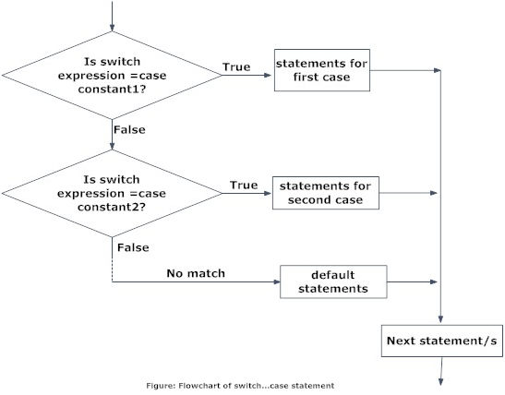

Slide 17
Rules for Switch
The switch expression must be an integer expression or character
The case label can either be integer or character constant.
No two label can have the same value
Case labels must end with a colon
The break statement transfers the control out of the switch statement
The break statement is optional. That is two or more case labels may belong to the same statements.
The default label is optional
There can be at most one default label.
The default usually placed at the end.
It is permitted to nest switch statements

Slide 18
#include<iostream>
main()
{
index = marks/10;
switch (index)
{
case 10:
case 9:
case8:
grade = “Honours‟;
break;
case 7:
case 6:
grade = “First Division‟;
break;
case 5:
grade = “Second Division‟;
break;
case 4:
grade = “Third Division‟;
break;
default: grade = “Fail‟;
break;
}
cout<< grade;
}

Slide 19
Index = marks / 10
Marks index
100 10
90 - 99 9
80 - 89 8
70 - 79 7
60 – 69 6
50 - 59 5
40 - 49 4
30 - 39 3
20 - 29 2
10 - 19 1
0 - 9 0

Slide 20
switch(ch) {
case '1':
cout<<"check_spelling\n";
break;
case '2':
cout<<"correct_errors\n";
break;
case '3':
cout<<"display_errors\n";
break;
default :
cout<<"No option selected";
}
getch();
return 0;
}
#include <cstdlib>
#include <iostream>
#include<conio.h>
using namespace std;
int main()
{
char ch;
cout<<"enter your choise\n";
ch = getchar(); /* read the selection from
the keyboard */

Slide 21
Write a program that will accept a man’s choice of food from the menu below using the switch statement
1 | Chips
2 | Rice
3 | Matooke
4 | Choma
Rewrite the program above using the if----else statement

Slide 22
Question Bank
1) Describe if-else statement.
2) In what way does switch statement differ from an if statement
3) Explain nested if-else statement execution
4) Write syntax for nested if-else statement.

Slide 23
Iteration Statements
Iteration statements (also called loops) allow a set of instructions to be executed repeatedly until a certain condition is reached.
The while loop
The do-while loop
The for loop

Slide 24
While loop
Its general form is:
while (condition)
{
statement;
}
The while is an entry-controlled loop statement.
The loop iterates while the condition is true. When the condition becomes false, program control passes to the line of code immediately following the loop.
The following example shows a keyboard input routine that simply loops until the user types A:

Slide 25
example
#include <iostream>
#include<conio.h>
int main()
{
char ch;
ch = '\0'; /* initialize ch */
while(ch != 'A')
cin>>ch;
getch();
return ch;
}

Slide 26
The do-while Loop
The general form of the do-while loop is:
do{
statement;
} while(condition);
Unlike for and while loops, which test the loop condition at the top of the loop, the do-while loop checks its condition at the bottom of the loop.
This means that a do-while loop always executes at least once.
The do-while loop iterates until condition becomes false.

Slide 27
example
#include <iostream>
#include<conio.h>
using namespace std;
int main()
{
int num;
do {
cin>>num;
} while(num > 100);
getch();
return 0;
}

Slide 28
#include <iostream>
#include<conio.h>
using namespace std;
int main()
{
int c=0;
int i=0;
char ch;
do
{
cout<<"Enter the number u want to add \n";
cin>>i;
c=c+i;
cout<<"do u want to enter another number? y/n \n";
cin>>ch;
}while(ch=='y');
cout<<"the sum of the numbers are: "<< c <<endl;
getch();
return 0;}
//Adding numbers

Slide 29
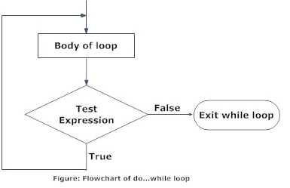
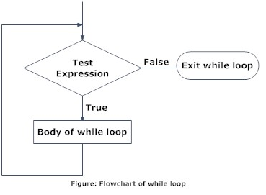

Slide 30
The for Loop
The general form of the for statement is:
for(initialization; condition; increment)
{
statement;
}
The initialization is an assignment statement that is used to set the loop control variable.
The condition is a relational expression that determines when the loop exits.
The increment defines how the loop control variable changes each time the loop is repeated.
You must separate these three major sections by semicolons.
The for loop continues to execute as long as the condition is true.
Once the condition becomes false, program execution resumes on the statement following the for.

Slide 31
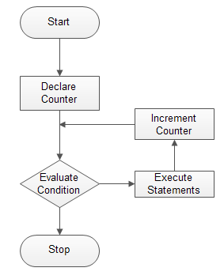

Slide 32
/* A program to print hello five times */
#include<iostream>
int main()
{
int i;
for(i=0; i<5; i++)
cout<<"Hello \n";
}
Output:
Hello
Hello
Hello
Hello
Hello

Slide 33
ADDING NUMBERS
#include <iostream>
#include<conio.h>
using namespace std;
int main()
{
int t=0, c;
cout<<"type the first number to add\n";
for(int i=0; i<=10; i++) { cin>>c;
cout<< "type another number to add"<<endl;
t=t+c;
}
cout<<"the sum is:" << t << endl;
getch();
return 0;
}

Slide 34
Multiplication Table
#include <iostream>
#include <conio.h>
int main()
{
int i, j;
for (i=1, j=1; i<10; i++, j++)
cout<< j<<"*"<< i<<"="<< j * i<<endl;
getch();
return 0;
}

Slide 35
Jump Statements
C++ has four statements that perform an unconditional branch:
return,
goto,
break,and
continue.
Of these, you may use return and goto anywhere in your program.
You may use the break and continue statements in conjunction with any of the loop statements.
You can also use break with switch.

Slide 36
The return Statement
The return statement is used to return from a function.
It is categorized as a jump statement because it causes execution to return (jump back) to the point at which the call to the function was made.
A return may or may not have a value associated with it.
If return has a value associated with it, that value becomes the return value of the function.
The general form of the return statement is:
return expression;

Slide 37
The goto Statement
The goto statement requires a label for operation.
A label is a valid identifier followed by a colon.
Furthermore, the label must be in the same function as the goto that uses it—you cannot jump between functions.
The general form of the goto statement is
goto label;
.
.
.
label:
where label is any valid label either before or after goto.
Class work:
Write a program to execute numbers 0-99 using for loop

Slide 38
#include <iostream>
#include<conio.h>
using namespace std;
int main()
{
int t;
for(t=0; t<100; t++)
{
cout<< t<<endl;
if(t==10) goto outOfLoop;
}
outOfLoop:
cout<<“ This is an Example using goto statement”<<endl;
getch();
return 0;
}

Slide 39
The break Statement
The break statement has two uses. You can use it to terminate a case in the switch statement
You can also use it to force immediate termination of a loop, bypassing the normal loop conditional test.
When the break statement is encountered inside a loop, the loop is immediately terminated and program control resumes at the next statement following the loop.

Slide 40
Example
#include <iostream>
#include<conio.h>
using namespace std;
int main()
{
int t;
for(t=0; t<100; t++) {
cout<< t<<endl;
if(t==10) break;
}
getch();
return 0;
}

Slide 41
The continue Statement
The continue statement works somewhat like the break statement. Instead of forcing termination, however, continue forces the next iteration of the loop to take place, skipping any code in between.
For the for loop, continue causes the conditional test and increment portions of the loop to execute.
For the while and do-while loops, program control passes to the conditional tests.

Slide 42
For example, we are going to skip the number 5 in our countdown:
// continue loop example
#include <iostream>
using namespace std;
int main ()
{
for (int n=10; n>0; n--) {
if (n==5) continue;
cout << n << ", ";
}
cout << "FIRE!\n";
return 0;
}
Output:
10, 9, 8, 7, 6, 4, 3, 2, 1, FIRE!

Slide 43


Slide 44
Chapter review questions
Explain the structure of a C++ program with an example.
Explain creating, compiling, linking and executing a C++ program.
Explain input statement.
Write about output statement
Explain about variables in C++ with an example program
What are the operators in C++? Explain.
Explain the if ..else statement with an example program.
What is the syntax of the switch case statement? Explain.
Discuss about the for looping.
Briefly explain the jump statements

